Slide 1

CDAAS Candidate Assignment
Components and Flow Of CI/CD Pipeline

Slide 2
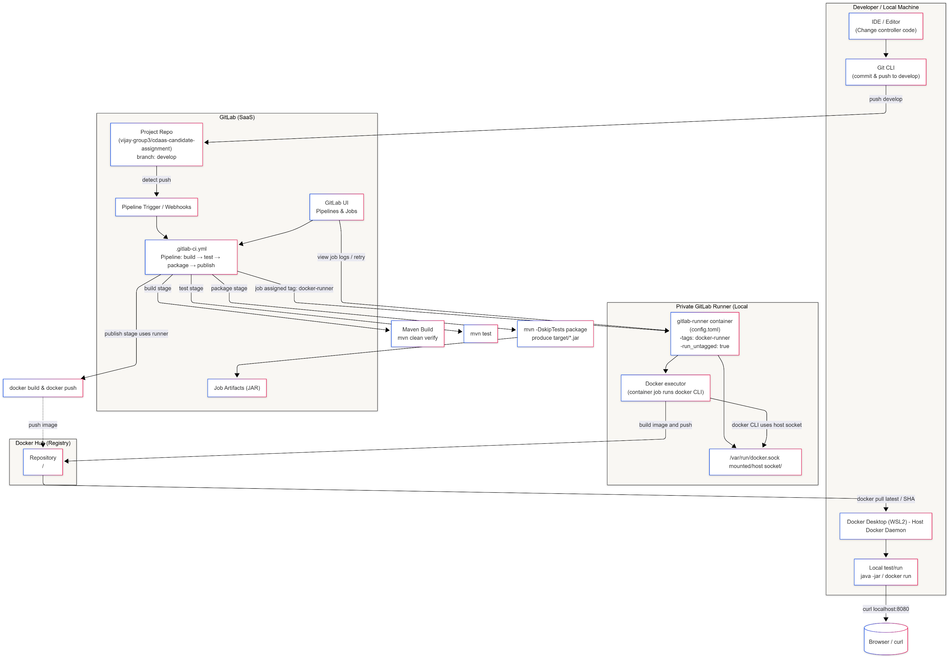
GitLab CI Docker Pipeline-Architecture Diagram

Slide 3
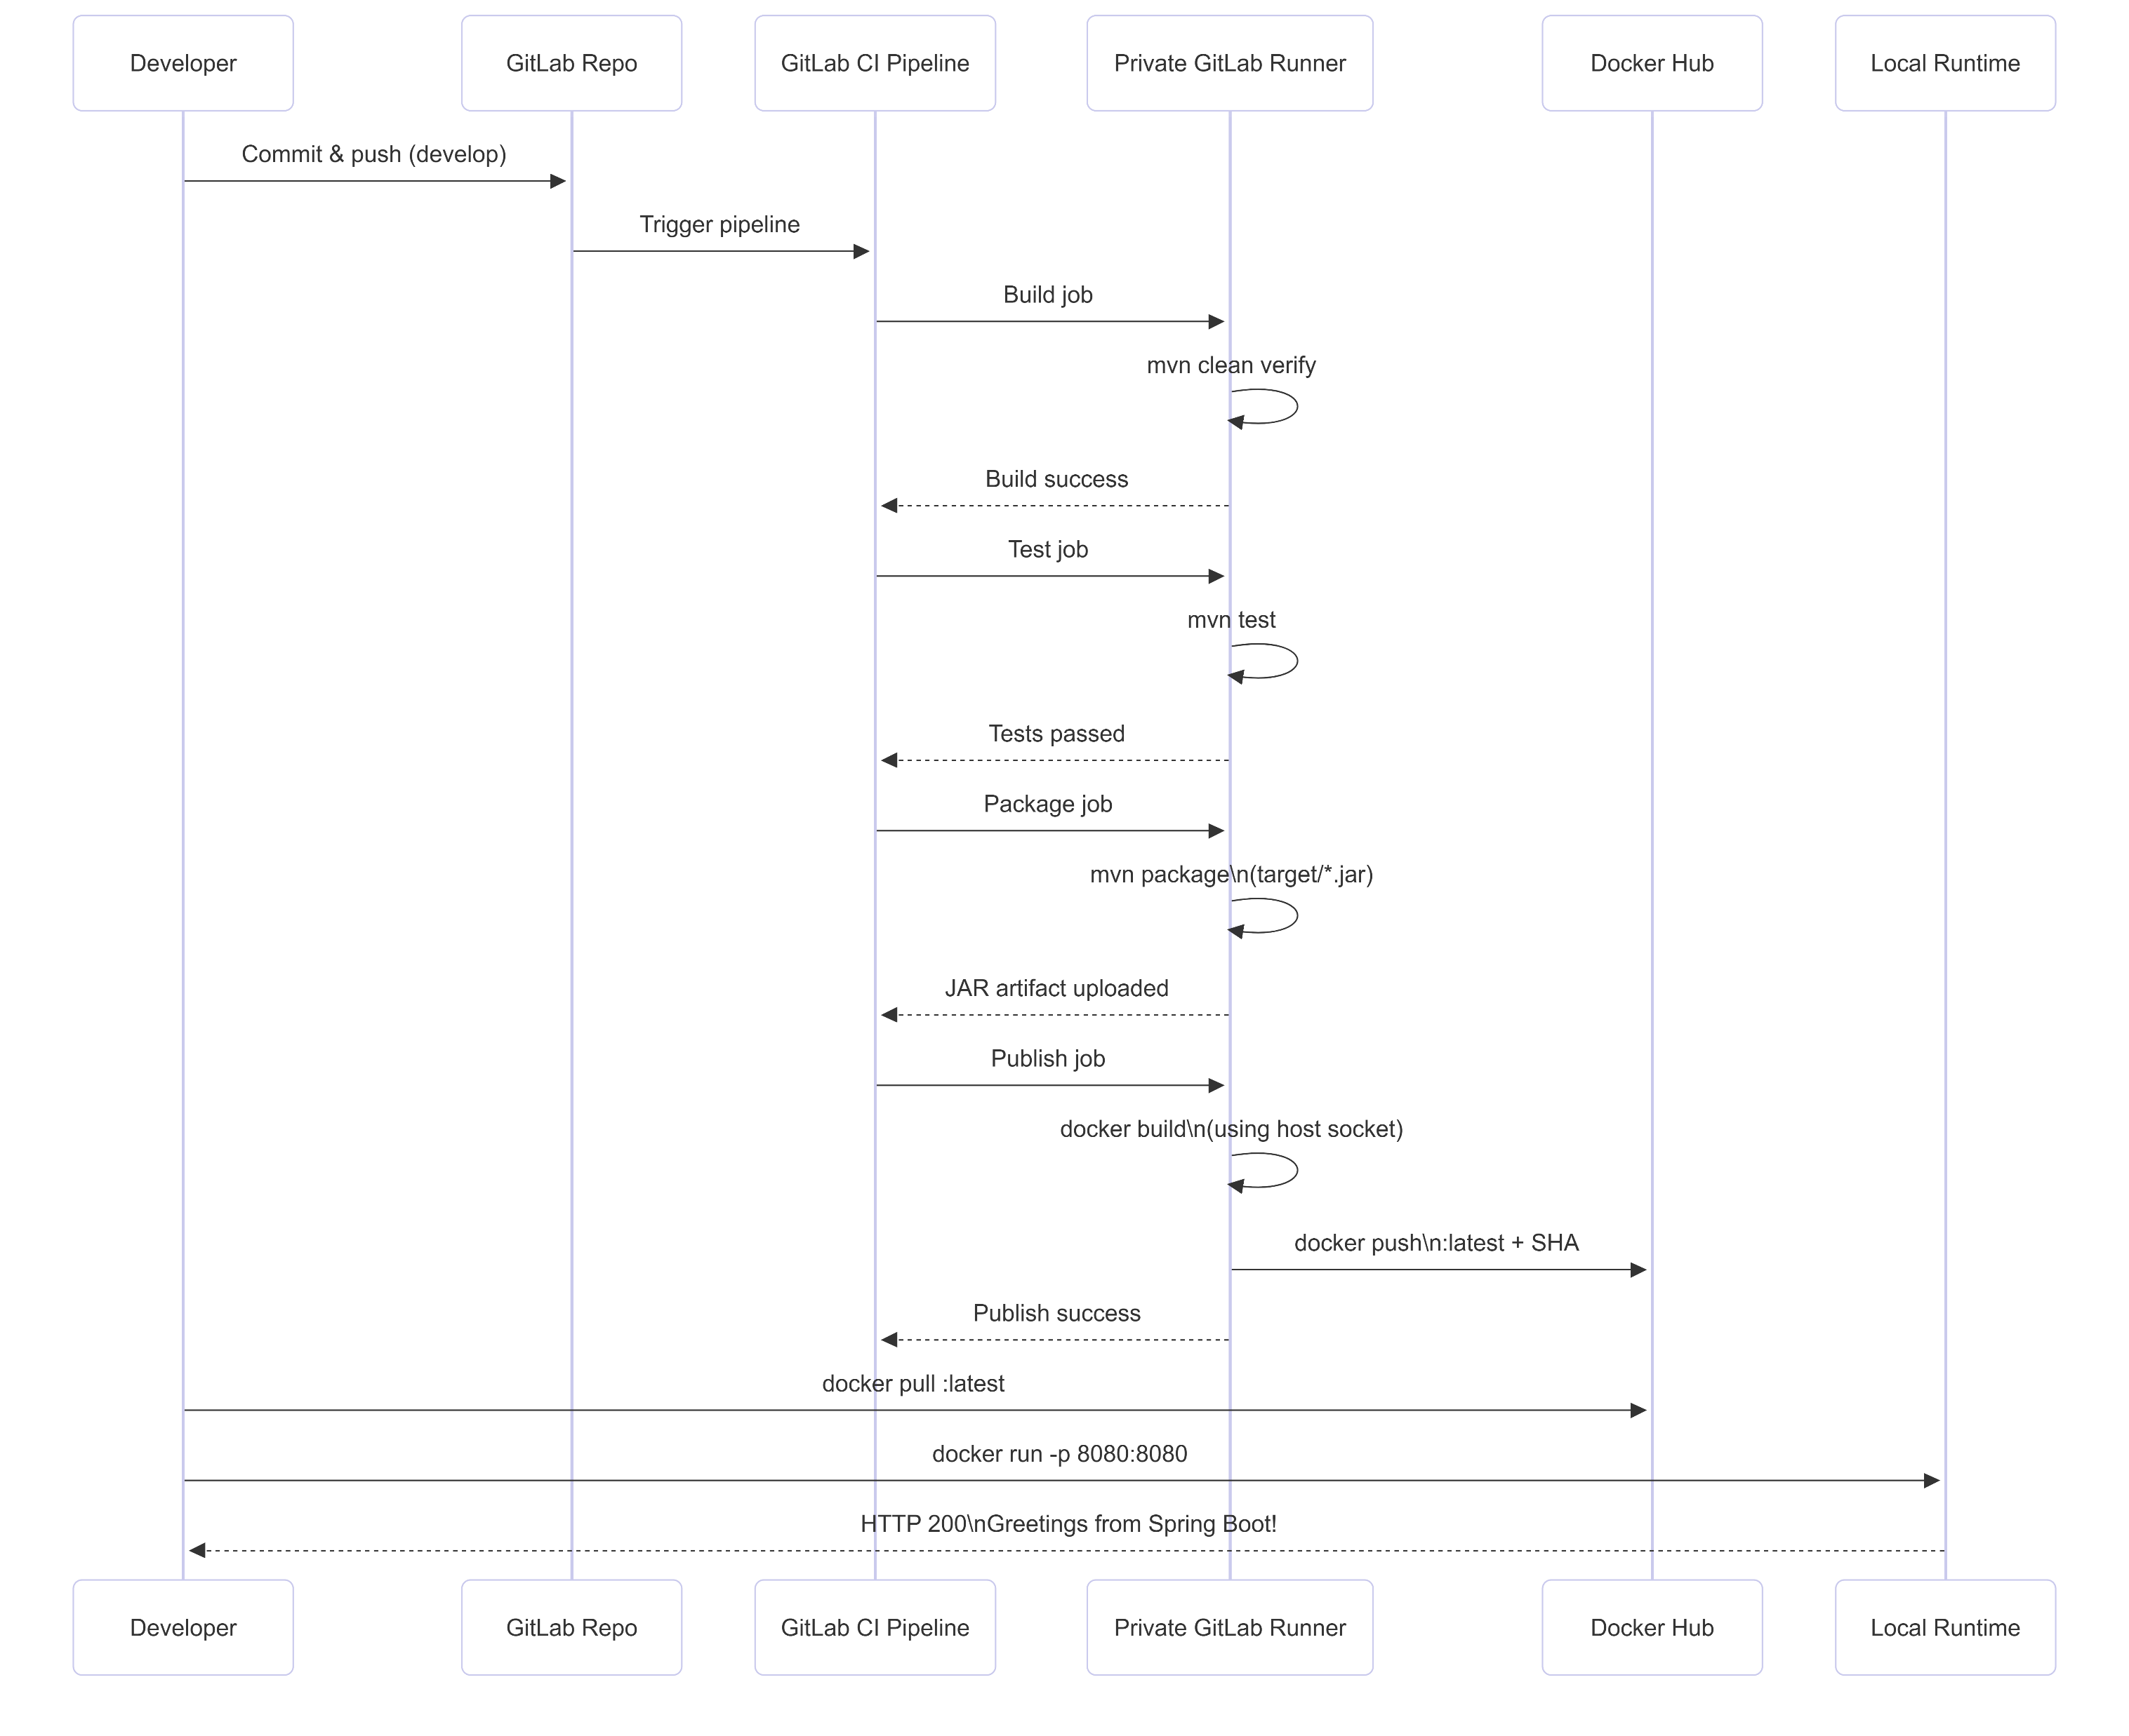
CI/CD Swimlane Diagram

Slide 4
Challenges - Real-World Engineering Experience . . .
GitLab Account & Pipeline Gating (Non-technical but Critical)
Challenge
GitLab blocked pipelines with the error:
“Identity verification is required in order to run CI jobs”
Pipelines failed silently until the account was verified.
Resolution
Completed identity verification via phone number + OTP.
Re-triggered pipelines manually (retry / empty commit).
Lesson
CI failures are not always technical.
Platform-level controls (security, abuse prevention) can block pipelines before any job executes.

Slide 5
Challenges - Real-World Engineering Experience . . .
GitLab Runner Registration & Visibility
Challenge
The private GitLab Runner initially showed:
“Runner has never contacted this instance”
Runner was running locally, but GitLab did not recognize it.
Root Causes
Missing or incorrect registration token.
Runner registered without tags.
Runner not allowed to run untagged jobs.
Resolution
Re-registered runner using project registration token.
Added:
tag_list = ["docker-runner"]
run_untagged = true
Verified connectivity with gitlab-runner verify.
Lesson
Runner availability ≠ runner eligibility.
Tags and job–runner matching are critical.

Slide 6
Challenges - Real-World Engineering Experience . . .
Windows + Docker Desktop Networking Pitfalls
Challenge
Docker-in-Docker (docker:dind) failed with:
lookup docker: no such host
Service containers were not consistently reachable.
Root Cause
Docker Desktop on Windows does not handle privileged sibling containers (DinD) as reliably as Linux.
Conflicting configurations (socket + DinD) worsened the issue.
Resolution
Abandoned DinD.
Switched to Docker socket mode:
volumes = ["/var/run/docker.sock:/var/run/docker.sock"]
Simplified job configuration by removing services: and DOCKER_HOST.
Lesson
Local CI runners ≠ Linux CI runners.
Tooling choices must fit the execution environment.

Slide 7
Challenges - Real-World Engineering Experience . . .
Docker Client vs Docker Server API Version Mismatch
Challenge
Publish stage failed with:
client version 1.43 is too old. Minimum supported API version is 1.44
Root Cause
Job container used an older Docker CLI image.
Host Docker Desktop daemon was very new (API 1.53).
Resolution
Upgraded job image to:
image: docker:latest
Added docker version logging for future diagnostics.
Lesson
In socket mode, client–server compatibility matters.
CI images must track daemon versions.

Slide 8
Challenges - Real-World Engineering Experience . . .
UTF-16 Encoding Corruption of config.toml
Challenge
Runner failed to start with:
files cannot contain NULL bytes; probably using UTF-16
Root Cause
Editing config.toml on Windows introduced UTF-16 encoding.
GitLab Runner requires UTF-8.
Resolution
Recreated config.toml inside the container using shell heredocs.
Avoided Windows editors for runner config.
Lesson
Cross-platform file encoding can break infrastructure tooling.
Always control encoding for config files.

Slide 9
Challenges - Real-World Engineering Experience . . .
Artifact & Image Freshness Confusion
Challenge
Pipeline succeeded, but browser still showed old controller output.
Docker Desktop was running an outdated container.
Root Cause
CI pushed a new image, but local runtime still used an old container.
latest tag was not pulled automatically.
Resolution
Manually:
docker pull <repo>/<image>:latest
docker stop <old-container>
docker run -p 8080:8080 <repo>/<image>:latest
Lesson
CI success ≠ runtime deployment.
Explicit pull & redeploy is required unless automated.

Slide 10
Challenges - Real-World Engineering Experience . . .
Debugging CI Requires Multi-Layer Visibility
Challenge
Failures occurred across:
GitLab UI
Runner logs
Job logs
Docker daemon logs
Resolution
Used:
docker logs gitlab-runner
Job log inspection
Temporary debug steps (env, docker version)
Incrementally isolated each failure.
Lesson
CI/CD debugging is systems debugging, not just code debugging.
Observability is essential.

Slide 11
Alternate Architectures and Tools . . .
Use GitLab Shared Runners + GitLab Container Registry
Use GitLab’s hosted shared runners to run CI jobs and push images to GitLab Container Registry (instead of Docker Hub). Minimal infra to manage.
Tools / Tech
GitLab.com shared runners (SaaS)
GitLab Container Registry (built-in)
.gitlab-ci.yml (similar pipeline)
GitLab CI variables for auth (if external registry)
Who benefits & why
Developer: Easiest onboarding — no runner maintenance; fast to start.
SRE/Ops: Low operational overhead; GitLab manages runner pool.
Security: Registry integrated with project; simpler RBAC.
Product/Management: Lower cost of maintenance; quicker velocity.
Trade-offs
Less control over runner environment; concurrency and quota limits on free tiers.
Potential privacy/compliance concerns (code/images stored on GitLab).
Slightly less flexibility for custom tooling on the runner.
When to pick
Small teams, demos, prototypes, or when you want minimal infra work.

Slide 12
Alternate Architectures and Tools . . .
GitLab Runner on Kubernetes (K8s Runner with Autoscaling)
Deploy GitLab Runner(s) into a Kubernetes cluster using the Kubernetes executor. Jobs run in ephemeral pods; use image build tools like kaniko, BuildKit, or kaniko + sidecar to build images and push to a registry (GitLab Container Registry / Docker Hub / ECR).
Tools / Tech
Kubernetes cluster (GKE / EKS / AKS / on-prem)
gitlab-runner Helm chart (Kubernetes executor)
kaniko / buildkit / img / docker-buildx action for building images
CI config uses kubernetes executor and service accounts
Container registry (GitLab/ECR/GCR/Artifactory)
Who benefits & why
Developer: Reproducible build environment; consistent with production K8s.
SRE/Ops: Scalability, autoscaling runners, RBAC, namespace isolation.
Security: Avoid privileged DinD; use Kubernetes RBAC, PodSecurityPolicy, and separate build service account.
QA/Product: Easier to deploy to staging clusters using the same platform.
Trade-offs
More operational complexity: cluster management, Helm charts, networking.
Needs expertise in Kubernetes.
Slight startup time for pods compared to shared runners.
When to pick
Teams already running K8s or planning to deploy to K8s. When you care about isolation, scalability, and security.

Slide 13
Alternate Architectures and Tools . . .
Use Dedicated Cloud CI Services for Builds (Cloud Build / GitHub Actions / Azure Pipelines)
Use a managed CI/CD provider specialized in builds (Google Cloud Build, GitHub Actions, Azure Pipelines) to build and push images, optionally integrated with GitLab via webhooks. Use their native build tooling (Buildpacks, Kaniko, BuildKit, or Cloud Build steps).
Tools / Tech
Cloud Build (GCP) or GitHub Actions / Azure Pipelines
Registry: GCR / GHCR / ACR / Docker Hub
Webhook integration from GitLab to trigger builds (or mirror repo to GitHub)
Who benefits & why
Developer: Highly managed pipelines, fast provisioning, built-in caching and integrations.
SRE/Ops: Offload resource management; easy audit logs.
Security: Managed service with hardened environment; easy to integrate scanning.
Management: Predictable costs and SLAs.
Trade-offs
Requires cross-system integration if primary repo is on GitLab.
Data residency and compliance considerations.
Potentially more expensive depending on usage.
When to pick
When you prefer managed build infrastructure or want native cloud integrations (e.g., push to GCR + deploy to GKE).

Slide 14
Alternate Architectures and Tools . . .
Use Docker-in-Docker (DinD) with Secure Runner on Linux VMs
Use private runners on Linux VMs configured with --privileged to run DinD services reliably. Use DinD when you need isolated build daemons per job.
Tools / Tech
Linux VM(s) (cloud or on-prem)
GitLab Runner using Docker executor with services: docker:dind
Runner config privileged = true
Image building via docker CLI inside job
Who benefits & why
Dev: High parity with traditional Docker workflows.
SRE/Ops: Full control over runner environment.
Security: Needs careful isolation (privileged containers); use VMs per runner if needed.
QA/Product: Suitable if image building must be isolated per job.
Trade-offs
Privileged mode is a security risk on shared hosts.
More resource usage (DinD overhead) and more complex networking.
Not recommended on Docker Desktop (Windows) due to fragility.
When to pick
When you need DinD features and can run on Linux VMs with controlled access.

Slide 15
Alternate Architectures and Tools . . .
Use BuildKit / docker buildx / Kaniko for Unprivileged Image Builds
Build images without requiring a privileged daemon or host socket. Use Kaniko or BuildKit/Buildx to produce images from within unprivileged containers or Kubernetes.
Tools / Tech
Kaniko (containerized image builder)
Buildx + remote BuildKit or BuildKit container
GitLab CI / K8s or runners that can run these tools
Registry (GHCR/ECR/GCR/Docker Hub)
Who benefits & why
Security: No privileged containers; safer in multi-tenant environments.
SRE/Ops: Can run builds in Kubernetes pod with limited permissions.
Developer: Faster and safer builds; caching support possible.
Management: Less operational risk.
Trade-offs
Kaniko performance is sometimes slower than native Docker build.
Buildx + BuildKit requires additional configuration for cache and remote usage.
Some image features (like mounting) behave differently.
When to pick
When security isolation is important and you run CI in Kubernetes or unprivileged runners.

Slide 16
Alternate Architectures and Tools . . .
Full GitOps Flow: Build ➜ Push ➜ Deploy using Helm & ArgoCD
After building and pushing images, automatically update deployment manifests (Helm values or Kustomize) and let ArgoCD/GitOps apply changes to clusters.
Tools / Tech
CI builds & registry (any of above)
Helm / Kustomize
ArgoCD / Flux (GitOps controllers)
Kubernetes cluster for staging/prod
Who benefits & why
Developer: Deploys are predictable and declarative from Git.
SRE/Ops: Clear audit trail and easy rollbacks with Git as single source of truth.
QA/Product: Faster, repeatable promotion to staging and production.
Management: Better compliance and traceability.
Trade-offs
Requires Kubernetes and GitOps maturity.
More moving parts: additional controllers to manage.
Additional learning curve.
When to pick
Teams aiming for continuous deployment and strong environment drift control.

Slide 17
Alternate Architectures and Tools . . .
Add Security & Compliance: SAST / DAST / Image Scanning / Attestation
Complement any pipeline with security scanning (Snyk, Trivy, Clair), SAST tools (Semgrep/SpotBugs), and image-signing (cosign/Notary); fail build on policy violations.
Tools / Tech
Trivy / Clair / Anchore / Snyk for image scanning
Semgrep / SpotBugs for code scanning
cosign / Notary for image signing and verification
GitLab CI security scanning features or external tools
Who benefits & why
Security: Early detection of vulnerabilities and policy enforcement.
Developer: Faster feedback on security issues.
Management: Compliance evidence and risk reduction.
Trade-offs
Additional pipeline time and complexity.
False positives need triage and process for remediation.
When to pick
Projects requiring security posture, compliance, or production readiness.

Slide 18
Alternate Architectures and Tools . . .
Infrastructure-as-Code for Runner Provisioning (Automation)
Instead of manual setup, automate runner lifecycle using Terraform / Ansible / Packer—makes repeatable, auditable runner provisioning.
Tools / Tech
Terraform / Cloud-init / Packer to create images
Ansible to configure GitLab Runner & Docker
CI to trigger runner provisioning
Who benefits & why
SRE/Ops: Reliable, reproducible runners; compliant configuration.
Developer: Predictable environments for builds.
Management: Lower human-error operational risk.
Trade-offs
Requires IaC expertise and initial investment.
Running cost for provisioned infrastructure.
When to pick
Larger teams or orgs that need standardized runner fleets.

Slide 19
Quick View
Solution | Tools | Pros | Cons | Best for
Shared Runners + GitLab Registry | GitLab.com | Quick, low maintenance | Less control, quotas | Small teams / demos
Runner on K8s + kaniko | K8s, kaniko, Helm | Autoscale, isolation, secure | Ops complexity | Teams on K8s
Cloud Build / Actions | GCB / GitHub Actions | Fully managed | Cross-system integration | Cloud-centric orgs
DinD on Linux VMs | GitLab Runner, DinD | Traditional Docker parity | Privileged, security risk | Controlled Linux infra
BuildKit / Kaniko | BuildKit/kaniko | No privileged, secure | Setup complexity | Multi-tenant / secure env
GitOps (ArgoCD/Flux) | ArgoCD + Helm | Declarative CD, auditability | Needs K8s + process | Mature teams with K8s
Security Scanning | Trivy/Snyk, cosign | Early detection and attestation | Extra time/complexity | Production systems
IaC Runner Provisioning | Terraform/Ansible | Reproducible infra | Initial investment | Medium/large orgs

Slide 20
Questions ?

